Slide 1


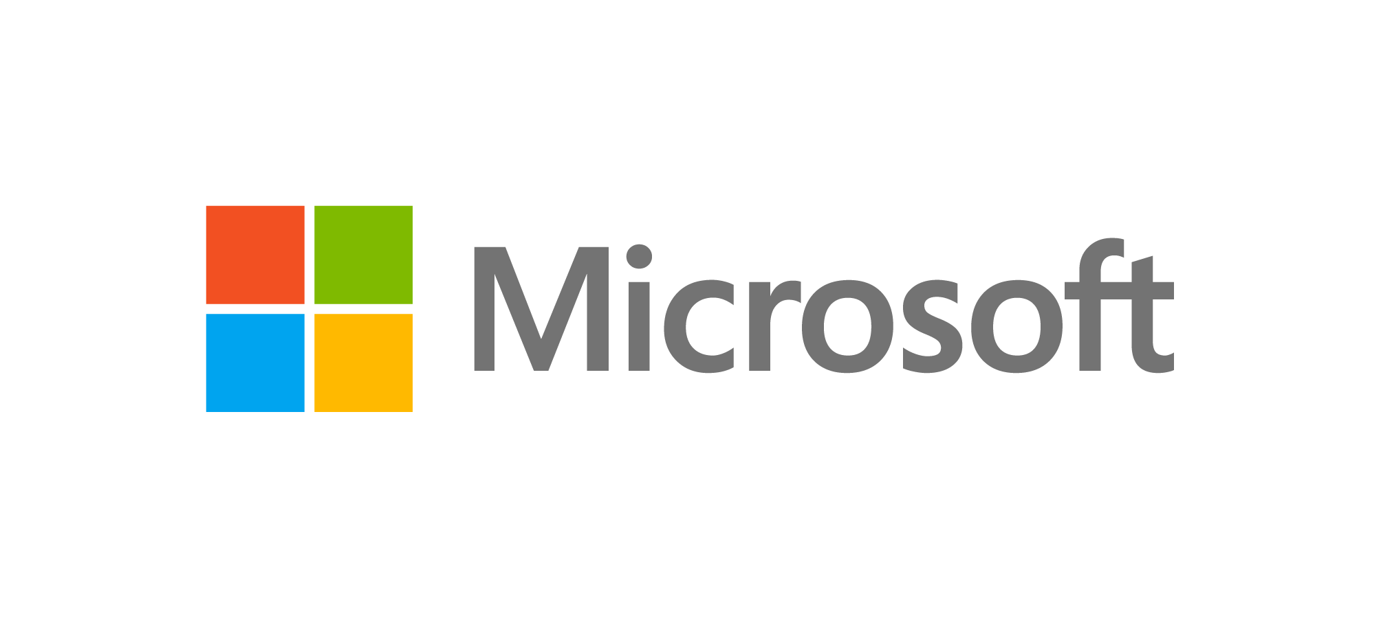
Microsoft Teams Rooms
Telesales Guide & FAQ
How to use
  This guide is designed to help you discuss the value and benefits of Microsoft Teams Rooms and explain how customers can get more value from Microsoft Teams by addressing the concerns and challenges associated with traditional meeting rooms. Feel free to customize the discussion as required, using the general flow as follows:
  Introduce yourself and the purpose of the call.
  Set the stage and gather information about the customer’s needs.
  Define Microsoft Teams Rooms. Tailor your conversation to your customer’s concerns from the opening questions.
  Handle any objections.
Target audiences
  For Office 365 users not using Microsoft Teams, lead with how Teams is the hub for teamwork in Office 365 that can also transform meeting rooms.
  For current Teams users, explain how employees are most likely familiar with using Teams for chat, calling, and online meetings. Now they can elevate that into a full meeting room experience.
Introduction
  Start with a customized greeting and explain the purpose of the call, such as:
  “If you have a few moments, I’d like to talk to you about how you are conducting your meetings. What are you currently doing in your conference rooms?”
  “I understand you are currently using Office 365. Are you using Microsoft Teams?”
Opening questions
1
  “What is your current meeting set-up like?
  How do you and your colleagues connect?”
  Virtual meetings are commonplace in today’s business world, and are expected to become
  more commonplace as people work remotely.
  Simple phone conferences just don’t cut it anymore; people expect to be able to collaborate online as if in-person.
  Many meeting rooms only have a phone and display or projector—fine for in-person meetings, but not so great with remote attendees.
  Most people join meetings from individual desks, but people also gather in ad-hoc meeting spaces.
2
  “What conference systems or solutions do you use today? Are you in the process of evaluating new solutions? What has kept you from purchasing them?”
  Traditional conferencing systems can be complicated and expensive to set up with
  a steep learning curve.
  The relatively high cost of traditional systems means that meeting rooms are at a premium and may not be easily available.
  There are many competing solutions for online meetings, not all of which provide seamless functionality.
Why Microsoft Teams?
  Teams is a complete online meetings solution.
Meet anywhere
  Consistent experience while at home, on the go, at your desk and in-room
  Supports all types of spontaneous, scheduled and formal connections:
  1:1, team to large groups
  Choices for internal, external, and broad communication
Meet with intelligence
  Ongoing, contextual collaboration keeps people connected and gets work done faster
  Bring your meeting to life with video; Easy sharing with content at your fingertips
  Remove distractions and focus your video on what matters most with Background Blur
Meet with confidence
  Meetings just work - Great audio/video and sharing over Wi-Fi and cellular networks
  Worldwide infrastructure and global peering points for optimized traffic
  Built with the security, compliance and manageability of Office 365
What is Microsoft Teams Rooms?
  Bring the Teams experience to every meeting.*
Transform your meeting rooms with Teams
  Teams feature set
  One-touch join
  Dial into a meeting or call someone’s phone
  Share with remote participants
  Center of room control
Make any space a Teams meeting place
  Anyone, anywhere, any device
  Dedicated Teams Meeting app
  Scales to all room sizes
  Integrate with existing investments
Easy to deploy, simple to manage
  Windows 10 device
  Universal app, managed
  through existing tools
  Low training effort
*Also works with Skype for Business

Slide 2
Microsoft Teams Rooms extends the Teams experience to meeting spaces
  Speak directly to the concerns the customer raised above.
 | Customer concern | Microsoft Teams Rooms
Transform your meeting room with Teams | “Our colleagues are in multiple places and are using a variety of devices.” “We don’t have a good way to set up meetings between conference rooms and individual attendees.” | Microsoft Teams Rooms help transform meeting rooms. You can plan or join meetings with one-touch join, share content easily in-room and with remote participants, and manage the meeting with a center of room control. Meetings are simple to create and join—regardless of where people are or what device they’re using. Proximity detection for Teams meetings makes it easy for you to discover and add nearby and available Microsoft Teams Rooms to any meeting. You can dial out of Teams meetings using regular phone lines.
Make any space a Teams meeting place | “We need more flexible meeting solutions.” | Microsoft Teams Rooms makes it simple to extend the Teams experience to any meeting room size. Microsoft Teams Rooms can be used instead of traditional conference phones and easily connect to displays, projectors, or other hardware you may already have. Microsoft Teams Rooms devices are available from best of breed vendors including Crestron, HP, Lenovo, Logitech, Polycom, and Yealink.*
Easy to deploy, simple to manage | “New conferencing solutions are hard to learn and manage.” | Microsoft Teams Rooms are Windows 10 devices, which means that they can be easily managed with other Microsoft management tools, such as System Center Configuration Manager and Microsoft Intune. Microsoft Teams Rooms bring the Teams experience to every meeting room, which means your colleagues can join and manage calls in a familiar way.
*Yealink coming soon
FAQ and objection handling
^{Objection} | ^{Response}
“I don’t need it.” | With Microsoft Teams Rooms you can replace the conference phone and bring an HD audio/video experience to a meeting space of your choice. Add a camera and all meeting participants can see each other and shared content—and work together as if they are in the same room. You can quickly schedule an ad-hoc meeting or join a planned one with one touch, which means you can start meetings on time and start collaborating faster.
“It’s too complex.” | Microsoft Teams Rooms are easy to set up and manage with an intuitive console that enables one-touch joining of conference calls. The console enables easy content sharing with remote participants, and the ability to dial in other participants. Your employees can also easily start meetings and monitor attendance, and you get enterprise-reliability as the foundation for a familiar Teams experience.
“You’re just trying to sell me more stuff.” | Microsoft Teams comes as part of your Office 365 or Microsoft 365 subscription. I’m offering you hardware that lets you optimize Teams with additional accessibility and functionality for your meeting rooms. Enjoy a familiar experience elevated with the latest in online meetings technology that can scale according to your needs.
“We like our current solution.” | When you get an online meeting solution based on Microsoft technologies, you get access to the full Microsoft partner ecosystem of solutions. Microsoft Teams Rooms pair with industry-leading hardware manufacturers for high quality experiences and trusted innovation. Microsoft Teams Rooms also make any space a Teams meeting place, for anyone, anywhere, on any device. Microsoft Teams Rooms provide a dedicated meeting app, scale to all room sizes, and integrate with existing investments.

